Slide 1
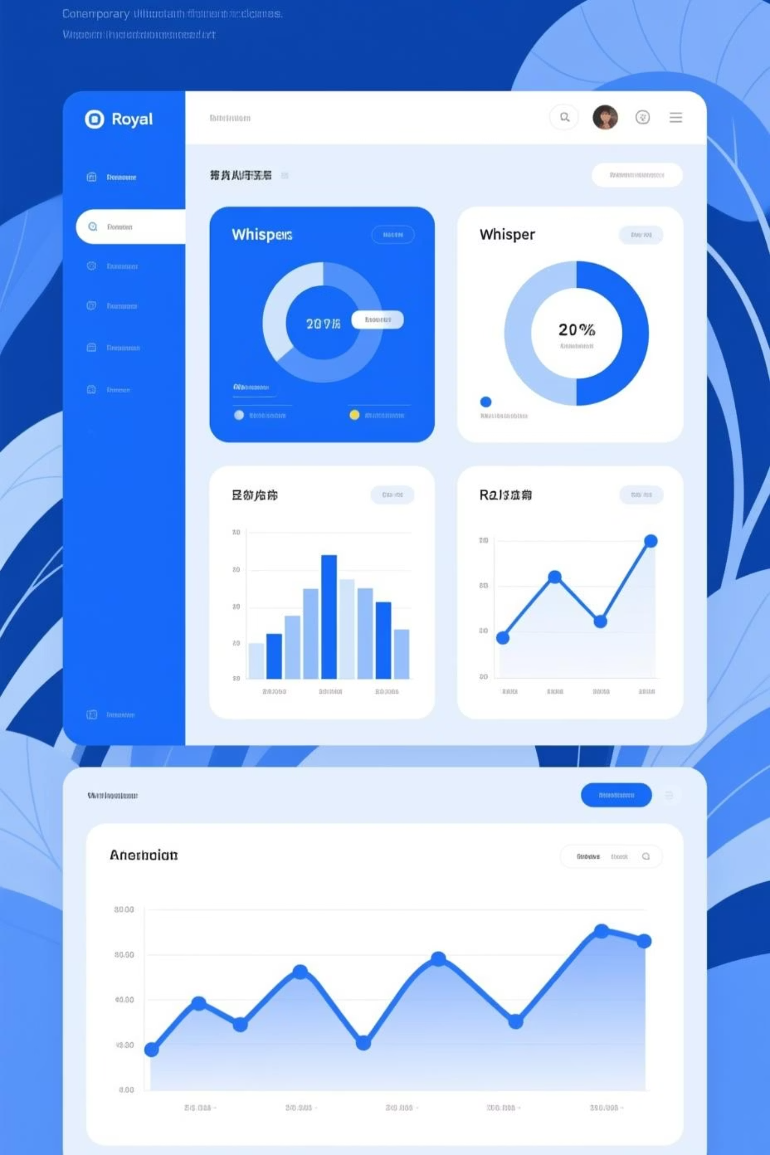

Expense Analysis using SQL & Python
Analysing family spending patterns with data visualisation
Tushar | Roll No. XX | November 2025

Slide 2
Expense Analysis using SQL & Python
Analysing family spending patterns with data visualisation
Tushar Shukla || 01 November 2025

Slide 3



Project Objective
Analyse Household Expenses
Identify Spending Categories
Enable Better Financial Planning
Utilize SQL and Python to extract valuable insights from family expense data and uncover financial behavior trends.
Recognize major expense categories and monthly variations to understand where and when most money is spent.
Used visual analytics to monitor spending patterns and make data-driven decisions for budgeting and savings.

Slide 4
Dataset Overview
Database Structure
Category
Amount
Date
The expense tracking system uses two relational tables: categories and expenses. The database contains comprehensive records of family spending across multiple categories over several months.
Travel
₹15,000
Nov 10
Groceries
₹4,500
Nov 15
Key Columns:
Bills
₹3,200
Nov 05
category_id (Primary/Foreign Key)
Entertainment
₹2,800
Nov 20
name (Category/Expense description)
amount (Expenditure value)
date (Transaction timestamp)

Slide 5
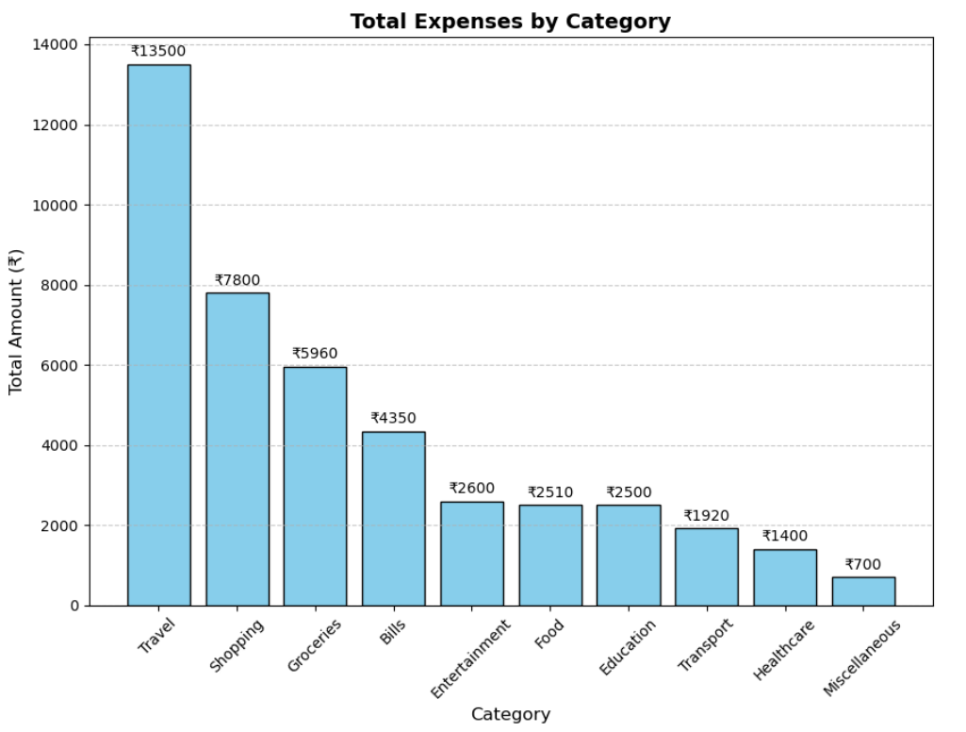
SQL Queries Implemented
Total Expenses by Category
SELECT c.name, SUM(e.amount)
FROM categories c
JOIN
expenses e
ON c.category_id = e.category_id
GROUP BY c.name;

Slide 6
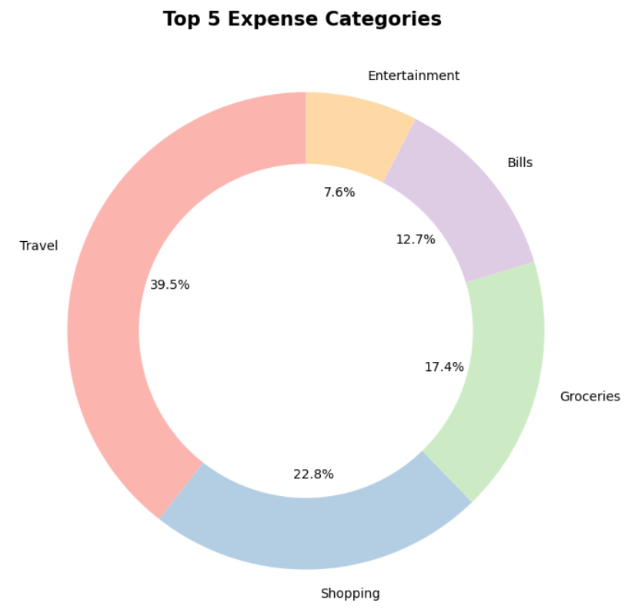
SQL Queries Implemented
Top 5 Expense Categories
SELECT c.name, SUM(e.amount) FROM categories c
JOIN
expenses e
GROUP BY c.name
ORDER BY SUM(e.amount) DESC LIMIT 5;

Slide 7
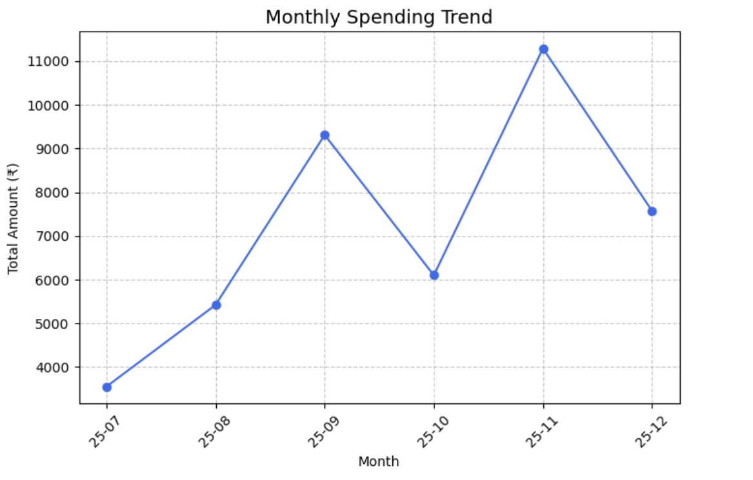
SQL Queries Implemented
Monthly Expense Trends
SELECT DATE_FORMAT(date, '%Y-%m'), SUM(amount)
FROM expenses
GROUP BY DATE_FORMAT(date, '%Y-%m');

Slide 8
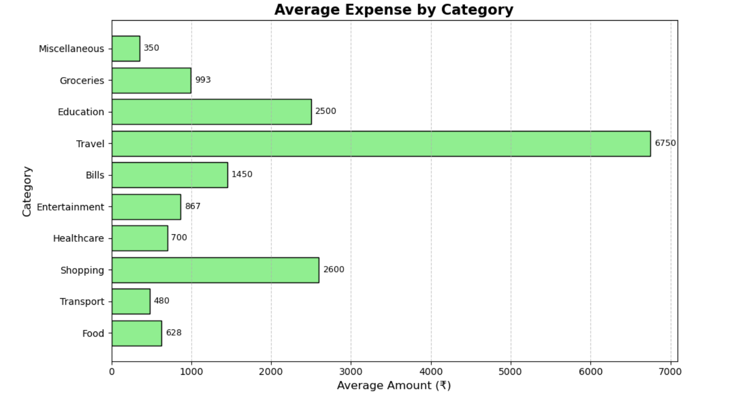
SQL Queries Implemented
Average Expenses per Category
SELECT c.name, AVG(e.amount)
FROM categories c
JOIN
expenses e
GROUP BY c.name;

Slide 9
Valuable Insight And Analysis
Travel Dominates Spending
Seasonal Spending Patterns
Travel expenses account for the largest share of total household spending, highlighting frequent vacations and trips as major cost drivers. This suggests a need for advance planning and use of budget-friendly travel options to manage costs effectively.
Expenses peak during November, driven by a family vacation and festive activities. Recognizing these patterns helps in anticipating high-spend months and setting aside funds in advance for smoother financial management.
Consistent Essential Expenses
Discretionary vs. Essential Balance
Bills and groceries remain steady throughout the year, forming the core monthly expenses.
The data shows that about 60% of expenses are discretionary (travel, entertainment, shopping), while 40% are essentials (groceries, bills, healthcare). This indicates an opportunity to rebalance towards savings and future goals.

Slide 10

Recommendation
Optimize Travel Spending
Plan trips in advance, compare transportation and stay options, and leverage seasonal discounts to lower travel expenses. Consider setting a fixed annual travel budget.
2. Set Monthly Expense Limits
Establish spending caps per category (e.g., groceries, shopping, entertainment) using insights from past data. Track real-time expenses using dashboards or spreadsheets.
3. Build a Savings Buffer
Redirect part of discretionary spending (especially from travel and entertainment) towards savings or emergency funds, ensuring long-term financial stability.
4. Monitor Seasonal Peaks
Prepare for high-spend months like November by saving in preceding months or distributing big expenses evenly across the year.
5. Regular Data Review
Use SQL and Python-based reports monthly to track spending trends, ensuring the family’s financial goals remain on target.

Slide 11

Conclusion
➡️ This project used SQL and Python to analyze household expenses and uncover spending patterns.
➡️ The analysis showed that travel is the largest expense, with
noticeable spikes during vacation months.
➡️ Bills and groceries remained consistent, forming a stable
spending baseline.
➡️ Overall, the project demonstrates how data analytics helps track
expenses, optimize budgets, and improve financial decisions.

